Slide 1
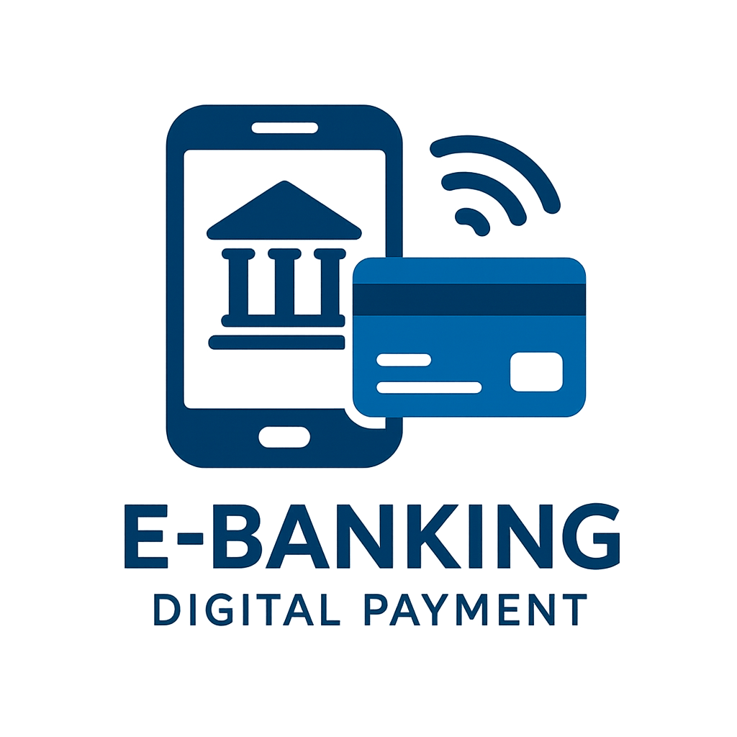

Slide 2
Introduction
E-Banking means using the internet and mobile to do banking activities.
No need to visit the bank for simple tasks like checking balance or transferring money.
Digital Payments allow money transactions through UPI, cards, wallets, and net banking.
They are fast, safe, and available 24/7.
Reduce the need for cash and make transactions more convenient.

Slide 3
Features of E-Banking
E-Banking provides 24/7 availability, allowing customers to access services anytime.
It allows quick and easy fund transfers within or outside the bank.
Customers can pay utility bills like electricity, gas, and mobile online.
It helps to check account balance and get mini statements instantly.
Through mobile and internet banking, customers can use apps and websites for services.
ATM services support cash withdrawal, deposits, and balance checks.
It enables online shopping and payments using cards, UPI, or wallets.
Strong security features like OTPs, PINs, and encryption keep transactions safe.
Customers can apply for loans and investment services such as FDs or RDs online.
Overall, e-banking offers convenience by saving time and reducing paperwork.

Slide 4
Types of Digital Payments
Internet Banking – Customers can access banking services through the bank’s official website.
Mobile Banking – Banking through mobile apps for fund transfers, bill payments, and balance check.
ATM Banking – Cash withdrawal, deposits, and account enquiry through Automated Teller Machines.
Debit & Credit Cards – Cashless payments and online transactions using bank cards.
Digital Wallets (e-Wallets) – Apps like Paytm, PhonePe, and Google Pay that store money digitally for payments.
Point of Sale (POS) Banking – Payments made directly through swiping cards or scanning QR codes at shops.
UPI (Unified Payments Interface) – Instant fund transfer using mobile number or UPI ID.

Slide 5
Challenges
There is always a risk of fraud and cybercrime, as hackers may try to steal sensitive information.
These services depend on internet and smartphone access, which is not available to everyone.
Sometimes technical issues or server downtime can interrupt transactions.
Many people, especially in rural areas, still have a lack of awareness or digital literacy.
Privacy and data security concerns arise when personal information is shared online.

Slide 6
Conclusion
E-Banking and Digital Payments have transformed the way we manage money. They bring ease, security, and accessibility to everyday transactions. With new technologies like AI and blockchain, the future will be smarter and more reliable. A strong move towards a cashless and empowered Digital India.

Slide 7
Thank you
For your attention
Presented by : Soha Sumra

